Slide 1

Escape Panic: the Role of a Leader
Wenzhe Chen, Yan Zhang
CSYS 302: Final Course Project, Prof. Laurent

Slide 2
Background and Research Question
Background:
One of the most disastrous forms of collective human behavior is the kind of crowd stampede induced by panic [1]. In a room when emergency happens, the role of leader should be very important.
Our Research Question:
How does a leader make a difference? Specifically, in a smoky room filled by certain amount of people who are trying to escape from the room, will a leader help people escape ?

Slide 3
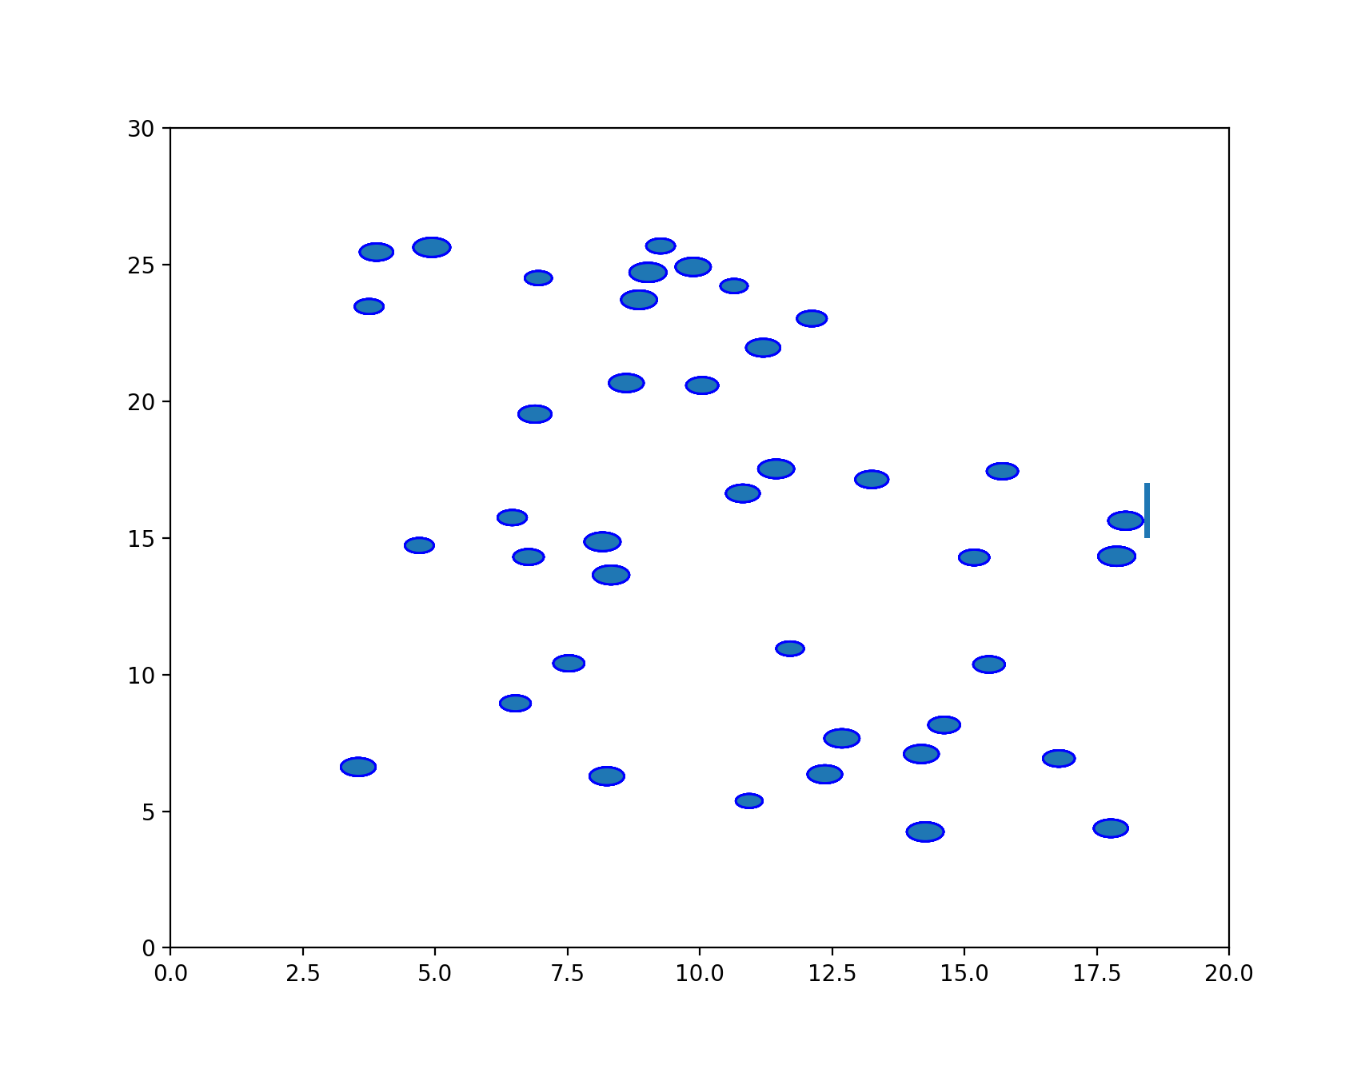
Model: Agent-Based Social-Psychological Model
Room(Environment):
Size is 20m x 30m
Single Exit
Smoky
People(Agents):
Each person is represented by a circle with certain radius. (0.25cm to 0.3cm)

Slide 4
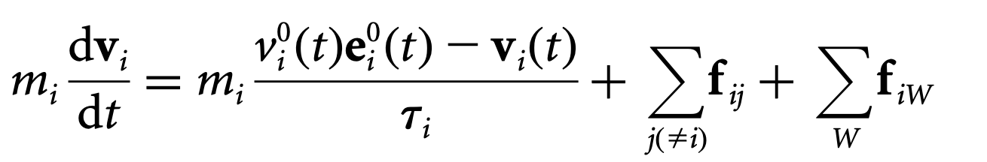
Model: Agent-Based Social-Psychological Model
Dynamic of people movement is modeled by Newton’s second law of motion.
The first term is the social-psychological force; it says that during an emergency situation, person i wants to move to a desired direction.
The second term is the sum of forces between any two people.
The third term is the sum of forces between a person and a wall.

Slide 5
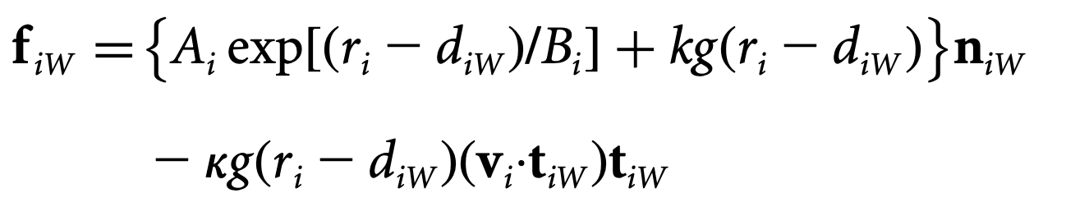
Forces
f_{iW} represents the repulsive interaction force between a wall and a person
f_{ij} represents the repulsive interaction force between person i and person j.

Slide 6
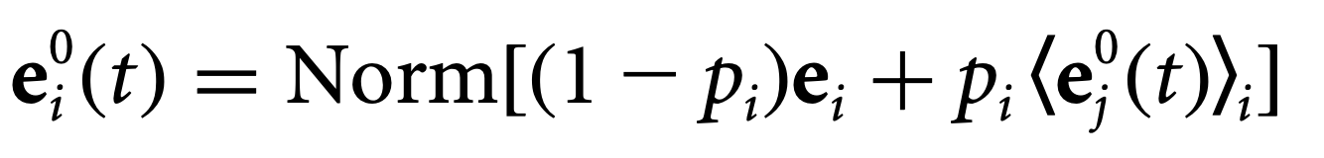
Panic Parameter:
e_{i} dasf

Slide 7
Assumptions: herding
In an emergency situation, people often show the so-called collective ‘herding’ behavior, i.e. when undergo panic feelings, people tend to run and follow other running people.

Slide 8
Assumptions: The role of leader
In a smoky room, the vision range of a person is about 3m to 4 m. Thus the first role of leader should be to inform everyone where the exit is.
Very often, when many people want to go through a single exit in an emergency situation, pushing and clogging happens.

Slide 9
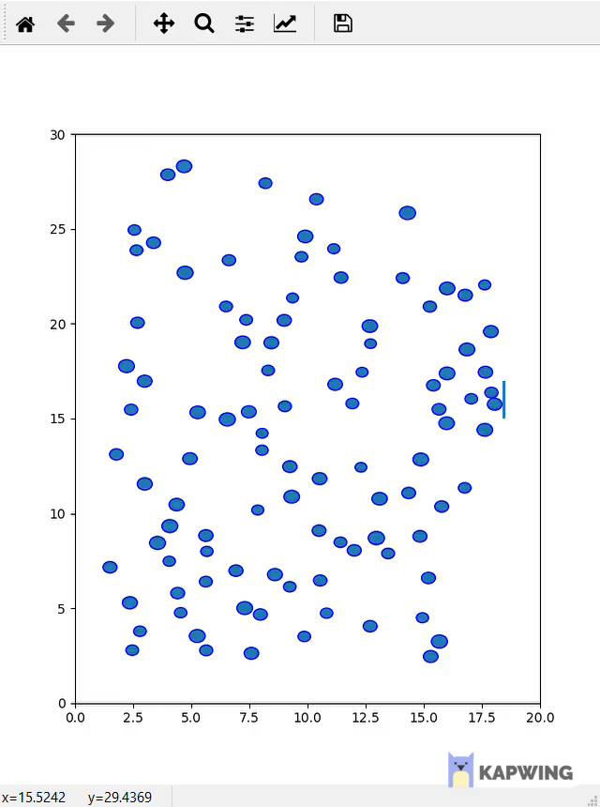
Result: Complete Panic, No leaders

Slide 10
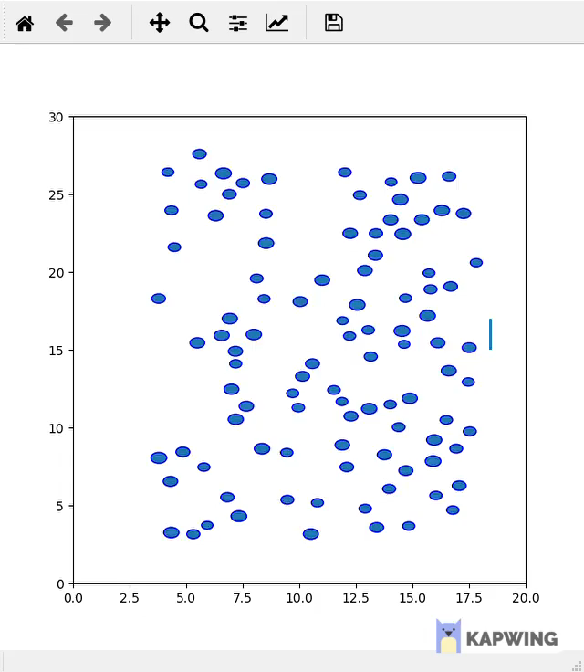
Result: The role of leaders

Slide 11
Future Work
1. How building design affects escape dynamics.
2. Compare different leader strategies.

